Slide 1
Customer Retention and Dynamic Pricing Analysis
Travel, Tourism and Hospitality Analytics Project

Slide 2
Introduction
The travel industry faces high revenue loss due to frequent booking cancellations.
Current systems cannot predict customer cancellations effectively.
Pricing strategies are static and do not adapt to demand changes.
This leads to poor revenue optimization.
Data-driven insights are needed to improve pricing and customer retention.

Slide 3

Project Objectives
Identify key factors driving customer cancellations (churn)
Analyze booking patterns and seasonal demand trends
Segment customers based on behavior and booking characteristics
Evaluate pricing patterns and elasticity
Build a foundation for dynamic pricing and retention strategies

Slide 4

Project Team
Prepared By: Gautam Jaiswal
Ramu Aradhyula
Nihla K
Minakshi Patil
Company Name: Infotact Solutions Pvt Ltd.

Slide 5

Key Performance Indicators (KPIs)
Cancellation Rate (%)
RevPAR
Booking Conversion Rate
Average Daily Rate (ADR)
Customer Segmentation Accuracy

Slide 6

Tools and Technologies Used
Python (Pandas, NumPy) for data cleaning and manipulation.
📈Matplotlib for plotting different graphs.
📊Power BI for interactive dashboards.
🧠Exploratory Data Analysis (EDA) techniques for data analysis.

Slide 7

Dataset Overview
Historical booking data
Key features
Lead Time
Booking Date
Deposit Type
Customer Type
Market Segment
Price (ADR)

Slide 8

Data Preprocessing
Handling missing values
Removing duplicates
Replace Missing values
Feature engineering

Slide 9

Exploratory Data Analysis
Cancellation Analysis
Booking Behaviour Analysis
Seasonal Demand Trends
Pricing Analysis

Slide 10
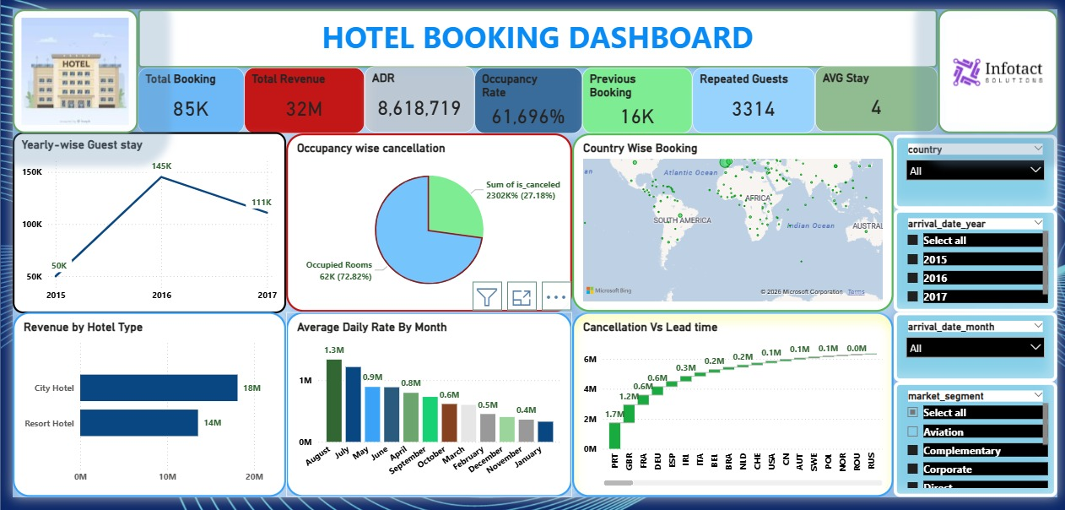
Power BI Dashboard

Slide 11
Conclusion
Data-driven analysis enables better decision-making in pricing and customer management.
Customer cancellation patterns can be effectively predicted using historical data.
Seasonal demand trends play a critical role in revenue optimization.
Dynamic pricing strategies help maximize Revenue Per Available Room (RevPAR).
Overall, analytics-driven approaches improve profitability and competitiveness in the hospitality industry.

Slide 12
Thank You..!

